Slide 1
First, precision grip error
Not well defined in the literature cited in the original text
Possible data characteristics:
The time difference between tip2 and tip1 entering apple's hitbox is too large (the thumb does not participate in the movement)
PiP2 too close to tip2 (excessive flexion of the distal interphalangeal joint)
tip2 Y value lower than apple Y value (stone holding)
Second, slit-hit error
Pause on the edge of the slit
Possible data characteristics:
tip1 or tip2 in excess of 15x*s/D frames in a band of x width centered on the slit edge (below the mean speed of the entire motion)
Third, wandering error
Touch the food pieces multiple times
Possible data characteristics:
After tip1 or tip2 enters apple's hitbox, the distance between tip1 and tip2 increases, and the range exceeds the image recognition error (reopen of index finger and thumb)
Fourth, unsuccessful
There are no pieces of food carried out from the slit
Possible data characteristics:
All identification points leave the slit when apple is not on the edge of the slit
We defined the three following types of errors.
A ‘precision grip error’ was judged by the same criteria as those used in a previous report.
If the finger touched but did not pass the edge of slit and stayed there for more than 66 ms (2 video frames), we judged it to be a ‘slit-hit error’.
If both fingers touched the food but the monkey released it and tried to pick it up again, we judged it as a ‘wandering error’. (Masaharu, 2012)

Slide 2
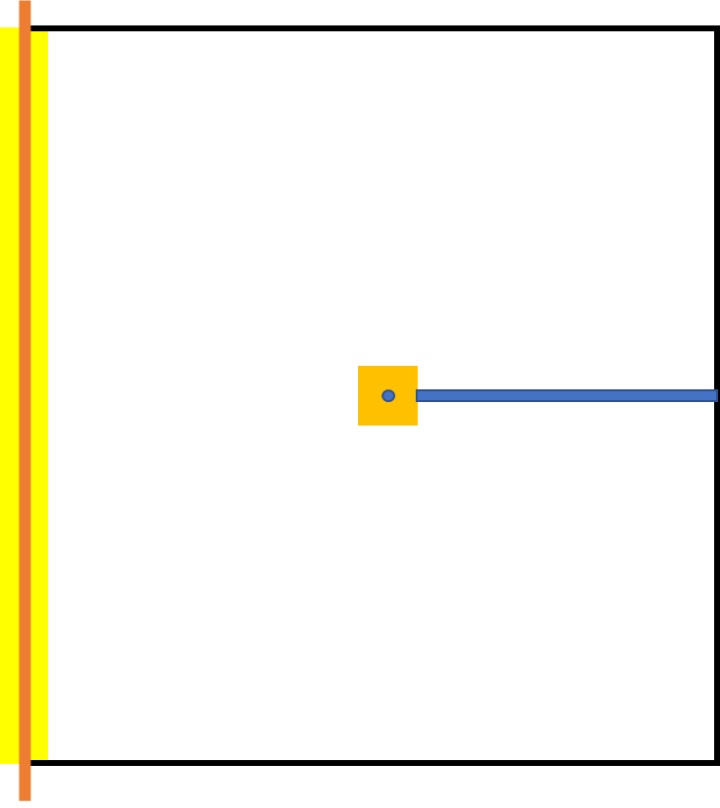
hitbox
judge “touch” when tip point in the range
apple point
pin
slit edge
passbox
judge “hit” when tip point stay in the range

